Slide 1
Welcome To Vehicle Requisition Project
Developer Team – C

Slide 2
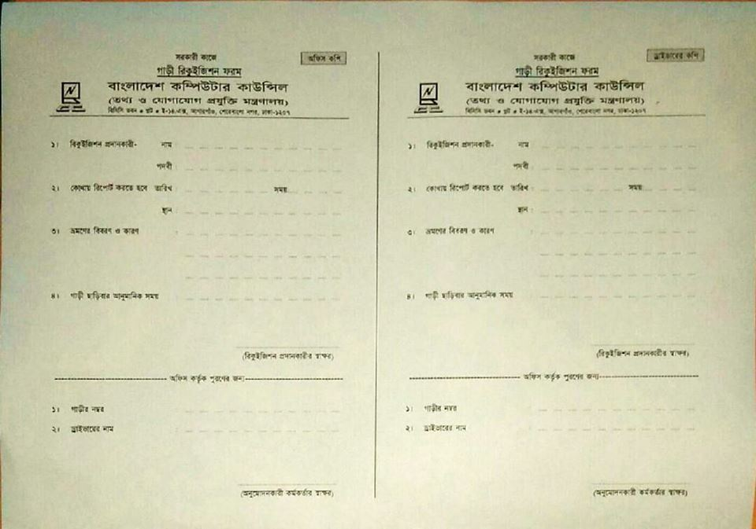
Goal of The System

Slide 3
Introduction
This requisition system for all of the employees of BCC. They can send request for vehicle of their various purposes. After Login Employee’s can submit a requisition request. On the other hand Controller assign a vehicle on request. Also user or controller can cancel a request or delete request.
The present vehicle requisition system is manually. Which is taking a long time to process a requisition and assign a vehicle.

Slide 4
System Characteristics
The system need in web based and easy to use.
The system expected basic computer knowledge user to use. Such as user easily login into the system, send a request and view history.
The system provides time efficiency to show vehicle, user profiles, send a requisition and quick response from vehicle controller to assign a vehicle to an employee.
The system sends a notification to the user.

Slide 5
Role Based System Characteristics
System Controller:
System controller can add vehicle, add vehicle controller and employee.
Vehicle Controller:
Vehicle controller can approve requests, cancel or delete request.
Employee:
The employee can send a requisition, cancel a requisition and edit a requisition. Also check all requests from him/her.
Driver:
Driver need a notification in a mobile message if assigning a trip for him.

Slide 6
Overview of Functional Requirements
The user must be authenticated to log in and log out from the site. Once a user get into the site, they may do some operations. Such as, if a user login as an employee, He or She can submit requests, view request, cancel request, etc. In addition, they can search for certain information on request which is submitted from them and print the search result.

Slide 7
Functional Requirements
Authorized users must be able to login with their identification number or user name and password.
After a successful login the user only view and do an operation which is authorized by the system controller.
After the login user (Employee) may do some operations, Like- submit a request, view request, Delete or cancel the request, etc.
After the login user (Vehicle Controller) may do some operations, Like- approve a request, assign vehicle on request, cancel or delete request, etc.

Slide 8
Security System
Only Authorized user will be permitted to access the system. This system will provide the user’s with a secure way to change their password and personal information.

Slide 9
System Development Environment
Application Development:
DOT NET Platform
ASP .NET MVC 5
Entity Framework (Code first approach)
HTML-5, CSS-3 and Bootstrap 3
Java Script & JQuery- 2.4
Application Database:
Microsoft SQL Server -2012

Slide 10
User Stories
Back Log for System Controller
As a system controller I want to get user list. So that create a user list.
As a system controller I want to create vehicle list. So that create a option for vehicle entry.
As a system controller I want to create a driver list. So that create a option for driver entry.
As a system controller I want to create employee list. So that create a option for employee entry.
As a system controller I want to deactivate vehicle, Employee and driver. So that create a option for deactivate.

Slide 11
User Stories
Back Log for Employee
As a Employee I want to login. So that create login form.
As a Employee I want to search vehicle. So that create search option.
As a Employee I want to send a requisition for vehicle. So that create requisition form.
As a Employee I want to cancel requisition. So that create cancel button.
As a Employee I want to select vehicle and driver. So that create a option for select.
As a Employee I want to get a conformation message in mail or mobile. So that create a info option.
As a Employee I want to print requisition copy . So that create a print option.

Slide 12
User Stories
Back Log for Vehicle Controller
As a vehicle controller I want to requisition search option. So that create a requisition list.
As a vehicle controller I want to approve requisition . So that create a requisition approve field in list.
As a vehicle controller I want to cancel or delete requisition. So that create a option.
As a admin I want to reassign requisition. So that create a option.
As a vehicle controller I want to create check-in or check-out . So that create a option.
As a vehicle controller I want to send conformation mail or message to employee and driver. So that create conformation info.

Slide 13
Use case Diagram
Log In
Vehicle Controller
Add Vehicle, Controller & Employee
System Controller
Requisition
Requisition Search
Employee
Check In
Check Out
Cancel Request
Re-Assign
Driver
Notification

Slide 14
VehicleType Entry Form (System Controller)
Object: VehicleType
Attribute
Id;
TypeName;
Description;
Activity:
CreateType();
EditVehicle();
Detais();
Delete();
TypeList();
Title | Text Box
TypeName*
Description

Slide 15
Vehicle Entry Form (System Controller)
Object: VehicleEntry
Attribute
Id;
VehicleTypeId;
RegNo;
Description;
DriverId;
IsDelete;
Activity:
Create();
Edit();
Detais();
Delete();
List();
Title | Text Box
Vehicle Type*
Registration No*
Driver
Description

Slide 16
Driver Entry Form (System Controller)
Object: DriverEntry
Attribute
Id;
Name;
LicenseNo;
MobileNo;
NID;
Address;
IsDelete;
Activity:
Create();
Edit();
Details();
Delete()
List();
Title | Text Box
Name
Mobile No
License No
NID
Vehicle Name
Address

Slide 17
Employee Designation Form (System Controller)
Object: EmployeeDesisgnation
Attribute
Id;
Designation;
Activity:
Create();
Edit();
Details();
Delete();
List();
Title | Text Box
Designation
Description

Slide 18
Employee Entry Form (System Controller)
Object: Employee
Attribute
Id;
Name;
DesignationId;
Email;
ContactNo;
Address;
Activity:
Create();
Edit();
Details();
Delete();
List();
Title | Text Box
Name
Designation
Email
Mobile No
Office Address

Slide 19
Requisition Form (Employee)
Object: Requisition
Attribute:
Id;
Employee;
JourneyStartDateTime;
JourneyEndDateTime;
SetCapacity;
JourneyFrom;
JourneyTo;
JourneyDescription;
Activity:
RequisitionList();
SearchRequisition();
SendRequisition();
CancelRequisition();
EditprofileInfo();

Slide 20
Vehicle Controller Form
Object: Requisition
Attribute:
Requisition;
Driver;
Vehicle;
CheckIn;
CheckOut;
Activity:
RequisitionList();
AddVehicle();
AddDriver();
ApproveRequisition();
CancelRequisition();
Re-Assign();
CheckIn();
CheckOut();

Slide 21
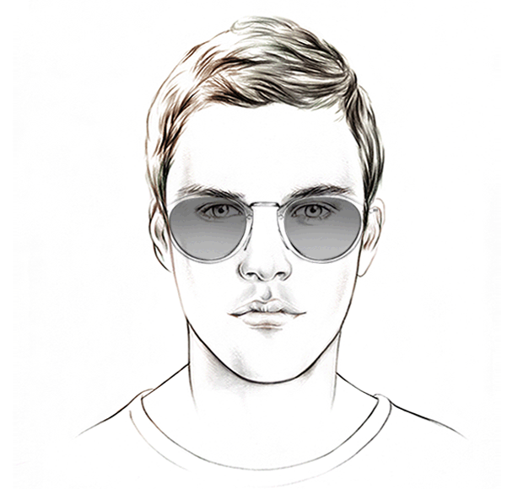
Employee View Diagram
Dash Board
Hi! user@mail.com
Logout
My Profile
Home > Dash Board
Send
Requisition
Personal Info
Name: Chitto Ranjan Sarker
Cell: +8801714863917
Email: chittoranjan.sarker@gmail.com
Gender: Male
My Request

Slide 22
Employee View Diagram
Dash Board
Hi! user@mail.com
Logout
My Profile
Home > My Profile
Send
Requisition
Personal Info
Name: Chitto Ranjan Sarker | Department: BKIICT
Cell: +8801714863917 | Address: Mohammadpur, Dhaka.
Email: chittoranjan.sarker@gmail.com
Designation: Programmer
My Request
Update

Slide 23
Employee View Diagram
Dash Board
Hi! user@mail.com
Logout
My Profile
Home > Update
Send
Requisition
Browse
My Request
Personal Info
Name: Chitto Ranjan Sarker | Department: BKIICT
Cell: +8801714863917 | Address: Mohammadpur, Dhaka.
Email: chittoranjan.sarker@gmail.com
Designation: Programmer
Update

Slide 24
Employee View Diagram
Dash Board
Hi! user@mail.com
Logout
My Profile
Home > Send Requisition
Send
Requisition
From :
My Request
To :
Journey Start :
Journey End :
Description :
No of Passenger:
Send

Slide 25
Employee View Diagram
Dash Board
Hi! user@mail.com
Logout
My Profile
Home >My Requisition
Search
Requisition
Requisition List
My Request
SL | From | To | Start Time | End Time | Description | No of Passenger | Status | Status
01 | BCC | Savar | 7/24/2018 2:00 PM | 7/24/2018 5:00 PM | Test | 2 | Pending
02 | BCC | Motijil | 7/20/2018 9:30 Am | 7/20/2018 1:30 PM | Test 2 | 3 | Approved
03 | Bcc | ddd | 7/24/2018 5:21 PM | 7/24/2018 5:21 PM | Test 3 | 5 | Ok
Edit
Cancel
View
Cancel
View
View
Previous
1
2
..
Next

Slide 26
Employee View Diagram
Dash Board
Hi! user@mail.com
Logout
My Profile
Home > View Requisition
Send
Requisition
Requisition Details
From: | DCC | Vehicle: | Toyota
To: | Motijil | Vehicle Reg No: | DhK Metro Kha-36254
Journey Start: | 7/24/2018 2:25 PM | Driver: | Chitto
Journey End: | 7/24/2018 2:25 PM | Driver Mobile No: | 01714863917
Description: | Test 2 | No of Passenger: | 5
My Request
Close

Slide 27
System Controller Diagram
Dash Board
Hi! user@mail.com
Logout
Add Vehicle
Home > Dash Board
Vehicle List
Personal Info
Name: Chitto Ranjan Sarker
Cell: +8801714863917
Email: chittoranjan.sarker@gmail.com
Gender: Male
ADD Driver
Driver List
Add Employee
Employee List

Slide 28
System Controller Diagram
Dash Board
Hi! user@mail.com
Logout
Add Vehicle
Home > Add Vehicle Type
Vehicle List
Vehicle Type :
Description :
ADD Driver
Driver List
Add Employee
Employee List

Slide 29
System Controller Diagram
Dash Board
Hi! user@mail.com
Logout
Add Vehicle
Home >Vehicle Type List
Search
Vehicle List
SL | Vehicle Type | Description | Action
01 | Car | Test 1
02 | Micro Bus | Test 2
03 | Jeep | Test 3
ADD Driver
Edit
Details
Delete
Driver List
Edit
Details
Delete
Add Employee
Edit
Details
Delete
Employee List
Previous
1
2
..
Next

Slide 30
System Controller Diagram
Dash Board
Hi! user@mail.com
Logout
Add Vehicle
Home > Add Vehicle
Vehicle List
Vehicle Type :
Vehicle Name :
Registration No:
Description :
ADD Driver
Driver List
Add Employee
Employee List
Save

Slide 31
System Controller Diagram
Dash Board
Hi! user@mail.com
Logout
Add Vehicle
Home >Vehicle List
Search
Vehicle List
SL | Vehicle Type | Vehicle Name | Description | Action
01 | Car | Corolla | Test 1
02 | Micro Bus | NOHA | Test 2
03 | Jeep | Pajero | Test 3
ADD Driver
Edit
Details
Delete
Driver List
Edit
Details
Delete
Add Employee
Edit
Details
Delete
Employee List
Previous
1
2
..
Next

Slide 32
System Controller Diagram
Dash Board
Hi! user@mail.com
Logout
Add Vehicle
Home > Add Driver
Vehicle List
Name:
Mobile No:
DL No :
Present Address
ADD Driver
Driver List
Add Employee
Employee List
Save

Slide 33
System Controller Diagram
Dash Board
Hi! user@mail.com
Logout
Add Vehicle
Home >Driver List
Search
Vehicle List
SL | Name | Mobile No | DL | Address | Action
01 | A | 222 | H-123 | aaa
02 | B | 3333 | CL-123 | bbb
03 | C | 4444 | L-123 | ccc
ADD Driver
Edit
Details
Delete
Driver List
Edit
Details
Delete
Add Employee
Edit
Details
Delete
Employee List
Previous
1
2
..
Next

Slide 34
System Controller Diagram
Dash Board
Hi! user@mail.com
Logout
Add Vehicle
Home > Add Department
Vehicle List
Department :
Description :
ADD Driver
Driver List
Add Employee
Employee List
Save

Slide 35
System Controller Diagram
Dash Board
Hi! user@mail.com
Logout
Add Vehicle
Home >Department List
Search
Vehicle List
SL | Department | Description | Action
01 | A | test
02 | B | Test
03 | C | test
ADD Driver
Edit
Details
Delete
Driver List
Edit
Details
Delete
Add Employee
Edit
Details
Delete
Employee List
Previous
1
2
..
Next

Slide 36
System Controller Diagram
Dash Board
Hi! user@mail.com
Logout
Add Vehicle
Home > Add Designation
Vehicle List
Department :
Designation :
Description :
ADD Driver
Driver List
Add Employee
Employee List
Save

Slide 37
System Controller Diagram
Dash Board
Hi! user@mail.com
Logout
Add Vehicle
Home >Designation List
Search
Vehicle List
SL | Department | Designation | Description | Action
01 | A | aa | test
02 | B | bb | Test
03 | C | cc | test
ADD Driver
Edit
Details
Delete
Driver List
Edit
Details
Delete
Add Employee
Edit
Details
Delete
Employee List
Previous
1
2
..
Next

Slide 38
System Controller Diagram
Dash Board
Hi! user@mail.com
Logout
Add Vehicle
Home > Add Employee
Vehicle List
Employee Info
Registration Info
ADD Driver
Employee Name :
Department :
Designation :
Mobile No :
Address :
User Mail :
Password :
Confirm Password :
Driver List
Add Employee
Employee List
Save

Slide 39
System Controller Diagram
Dash Board
Hi! user@mail.com
Logout
Add Vehicle
Home >Employee List
Search
Vehicle List
SL | Name | Dept. | Desig. | Mob No | Address | Action
01 | Mr. | A | aa | 11 | Sss
02 | Mr. | B | bb | 22 | Ddd
03 | Mrs. | C | cc | 33 | ggg
ADD Driver
Edit
Details
Delete
Driver List
Edit
Details
Delete
Add Employee
Edit
Details
Delete
Employee List
Previous
1
2
..
Next

Slide 40
Vehicle Controller Diagram
Dash Board
Hi! user@mail.com
Logout
Requisition List
Home >Requisition List
Search
SL | From | To | Start Time | End Time | Description | Name | Des. | Dept. | Status | Action
01 | BCC | Savar | 7/24/2018 2:00 PM | 7/24/2018 5:00 PM | Test | aaa | ddd | ddd | Pending
02 | BCC | Motijil | 7/20/2018 9:30 Am | 7/20/2018 1:30 PM | Test 2 | ccc | ee | fff | Approved
03 | bcc | ddd | 7/24/2018 4:58 PM | 7/24/2018 4:59 PM | test3 | ddd | sss | eee | Ok
Driver List
Employee List
Approve
Cancel
Check In
Re
assign
Cancel
Check out
Previous
1
2
..
Next

Slide 41
Vehicle Controller Diagram
Dash Board
Hi! user@mail.com
Logout
Requisition List
Home >Requisition
Vehicle Assign
Driver List
From
To
Journey Start
Journey End
Description
No of Passenger
Description
Vehicle
Driver
Employee List
Check In
Approved
Check out

Slide 42
Vehicle Controller Diagram
Dash Board
Hi! user@mail.com
Logout
Requisition List
Home >Check Out
Check Out Status
Search
SL | From | To | Start Time | End Time | Description | Name | Des. | Dept. | Status | Action
01 | BCC | Savar | 7/24/2018 2:00 PM | 7/24/2018 5:00 PM | Test | aaa | ddd | ddd | Approved
02 | BCC | Motijil | 7/20/2018 9:30 Am | 7/20/2018 1:30 PM | Test 2 | ccc | ee | fff | Approved
Driver List
Employee List
Check out
Check In
Check Out
Check out
Previous
1
2
..
Next

Slide 43
Vehicle Controller Diagram
Dash Board
Hi! user@mail.com
Logout
Requisition List
Home >Check In
Check In Status
Search
SL | From | To | Start Time | End Time | Description | Name | Des. | Dept. | Status | Action
01 | BCC | Savar | 7/24/2018 2:00 PM | 7/24/2018 5:00 PM | Test | aaa | ddd | ddd | Approved
02 | BCC | Motijil | 7/20/2018 9:30 Am | 7/20/2018 1:30 PM | Test 2 | ccc | ee | fff | Ok
Driver List
Employee List
Check In
Check In
Check In
Check out
Previous
1
2
..
Next

Slide 44
System Developer
Team Leader:
Md. Enamul Haque
Team Members:
Md. Masum Bella
Mst. Luthfunnesa Sultana
Mst. Benjeer Haque
Chitto Ranjan Sarker

Slide 45
Thanks To All

